Slide 1
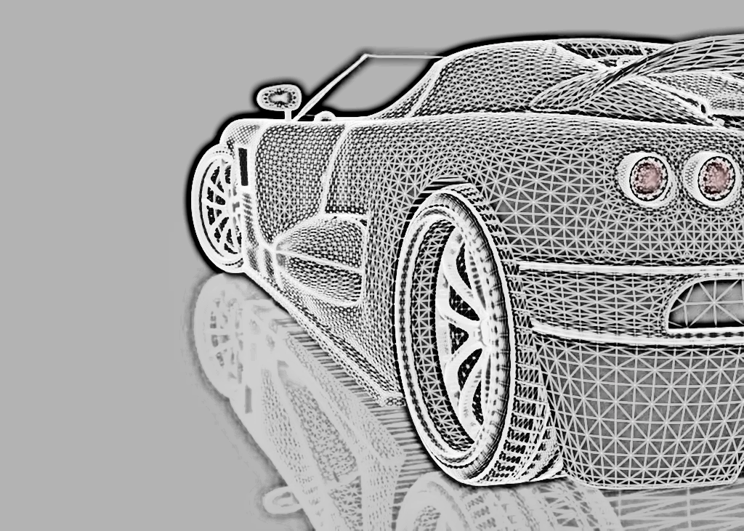
CAPSTONE PROJECT
NTUC SCTP
MACHINE LEARNING-
SGCARMART USED CAR PRICE PREDICTION
By Eugene Tan

Slide 2
The Data Revolution: Machine Learning Driving Transformation
Introduction
Organizations today gather vast data daily to shape business strategies, driving demand for Data Scientists and Analysts. Machine Learning and AI lead this transformation, making data the “backbone” of the 21st century. These technologies are now essential across sectors, reducing manual tasks.
In the automotive industry, they have revolutionized driving experiences.
Notes:
In today’s data-driven world, organizations are amassing vast quantities of information daily to inform their business strategies and solutions. This surge in data has led to a skyrocketing demand for Data Scientists and Data Analysts. Machine Learning and Artificial Intelligence are at the forefront of this transformation, paving the way for a brighter future. Data has become the “backbone” of the 21st century, with Machine Learning serving as the engine that harnesses its potential.
Machine Learning and AI are now integral to almost every sector. Companies are integrating smart AI solutions to reduce manual interventions. Focusing on cars, we can see how these technologies have revolutionized driving experiences.

Slide 3
Data Extraction and Preprocessing: Machine Learning Model Development: Model Interpretation and Insights:
Retrieves used car data from sgcarmart.com by scraping individual listings.
Extracts attributes like brand, price, depreciation, registration date, mileage, etc.
Handles missing or inconsistent data using try-except blocks and cleaning techniques.
Predicting Used Car Prices: A Data-Driven Approach

Slide 4
Data Extraction and Preprocessing: Machine Learning Model Development: Model Interpretation and Insights:
Trains a Random Forest Regression model to predict used car prices.
Performs feature selection to identify the most relevant attributes.
Evaluates the model's performance using R-squared, Mean Absolute Error (MAE), Mean Squared Error (MSE), and Root Mean Squared Error (RMSE).
Predicting Used Car Prices: A Data-Driven Approach

Slide 5
Data Extraction and Preprocessing: Machine Learning Model Development: Model Interpretation and Insights:
Analyzes feature importance to understand key price drivers.
Provides insights into the relationship between features vs price.
Predicting Used Car Prices: A Data-Driven Approach

Slide 6
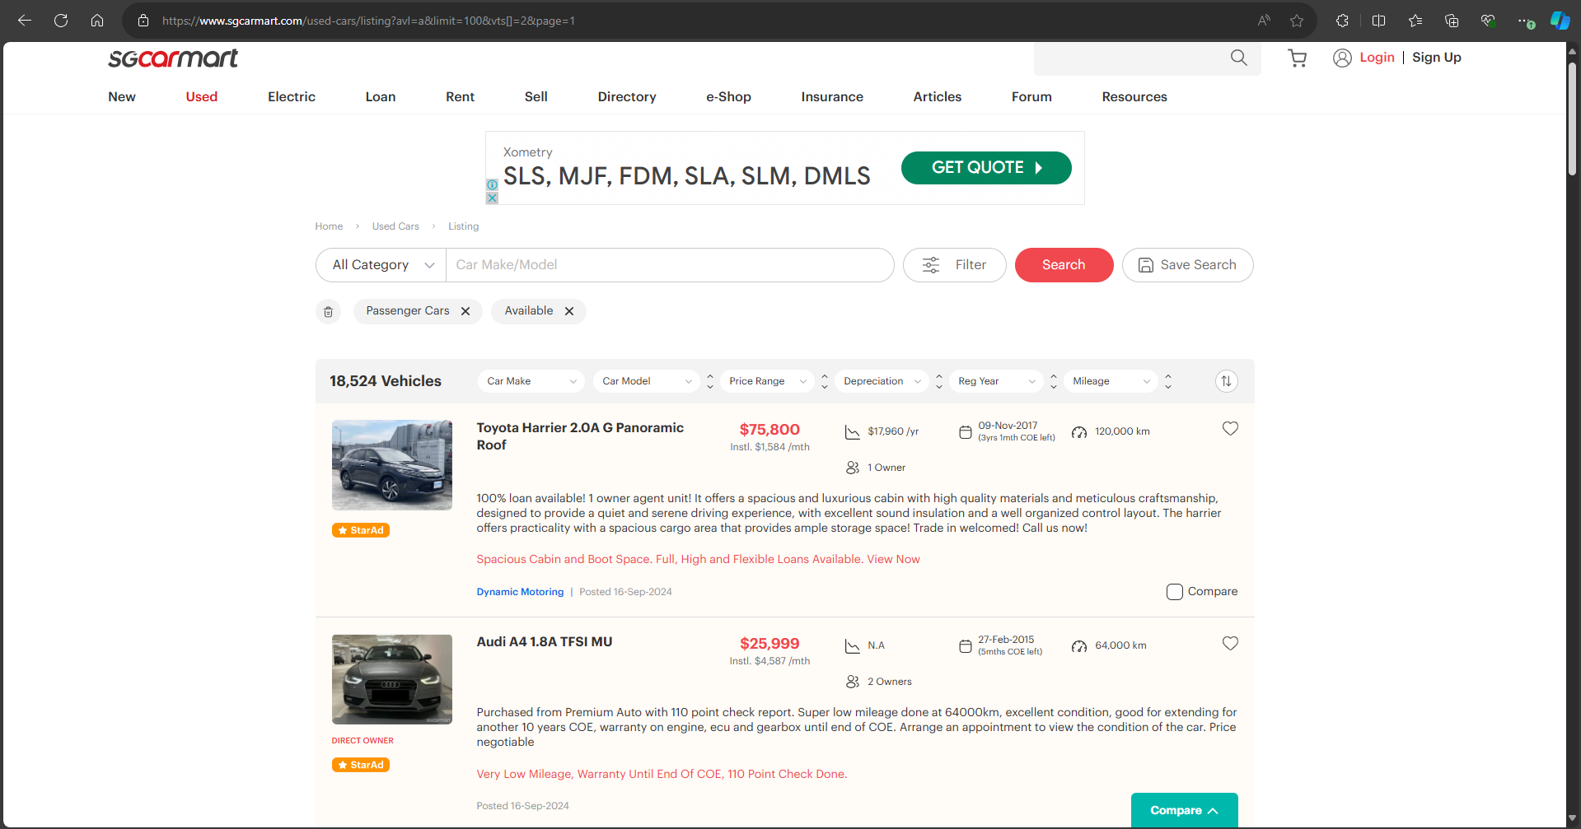
Retrieval of Individual Listing URLs from Search Pages
Data Extraction
https://www.sgcarmart.com/used_cars/info.php?ID=1293490&DL=4524\
https://www.sgcarmart.com/used_cars/info.php?ID=1335107&DL=2876\
https://www.sgcarmart.com/used_cars/info.php?ID=1319958&DL=1188\
https://www.sgcarmart.com/used_cars/info.php?ID=1335957&DL=4014\
https://www.sgcarmart.com/used_cars/info.php?ID=1319609&DL=2875\
https://www.sgcarmart.com/used_cars/info.php?ID=1317859&DL=4516\
https://www.sgcarmart.com/used_cars/info.php?ID=1336144&DL=2547\
https://www.sgcarmart.com/used_cars/info.php?ID=1333407&DL=1136\
https://www.sgcarmart.com/used_cars/info.php?ID=1238413&DL=2958\
https://www.sgcarmart.com/used_cars/info.php?ID=1310552&DL=4731\
https://www.sgcarmart.com/used_cars/info.php?ID=1336120&DL=4298\
https://www.sgcarmart.com/used_cars/info.php?ID=1332855&DL=4343\
https://www.sgcarmart.com/used_cars/info.php?ID=1300697&DL=3392\
https://www.sgcarmart.com/used_cars/info.php?ID=1312030&DL=4111\
https://www.sgcarmart.com/used_cars/info.php?ID=1263451&DL=2339\
https://www.sgcarmart.com/used_cars/info.php?ID=1303473&DL=3723\
https://www.sgcarmart.com/used_cars/info.php?ID=1318293&DL=2984\
https://www.sgcarmart.com/used_cars/info.php?ID=1334057&DL=2549\
https://www.sgcarmart.com/used_cars/info.php?ID=1332636&DL=3414\
etc
['https://www.sgcarmart.com/used-cars/listing?avl=a&limit=100&vts[]=2&page=1', 'https://www.sgcarmart.com/used-cars/listing?avl=a&limit=100&vts[]=2&page=2', 'https://www.sgcarmart.com/used-cars/listing?avl=a&limit=100&vts[]=2&page=3', 'https://www.sgcarmart.com/used-cars/listing?avl=a&limit=100&vts[]=2&page=4', 'https://www.sgcarmart.com/used-cars/listing?avl=a&limit=100&vts[]=2&page=5', 'https://www.sgcarmart.com/used-cars/listing?avl=a&limit=100&vts[]=2&page=6', 'https://www.sgcarmart.com/used-cars/listing?avl=a&limit=100&vts[]=2&page=7', 'https://www.sgcarmart.com/used-cars/listing?avl=a&limit=100&vts[]=2&page=8', 'https://www.sgcarmart.com/used-cars/listing?avl=a&limit=100&vts[]=2&page=9', 'https://www.sgcarmart.com/used-cars/listing?avl=a&limit=100&vts[]=2&page=10', 'https://www.sgcarmart.com/used-cars/listing?avl=a&limit=100&vts[]=2&page=11', 'https://www.sgcarmart.com/used-cars/listing?avl=a&limit=100&vts[]=2&page=12', 'https://www.sgcarmart.com/used-cars/listing?avl=a&limit=100&vts[]=2&page=13', 'https://www.sgcarmart.com/used-cars/listing?avl=a&limit=100&vts[]=2&page=14', 'https://www.sgcarmart.com/used-cars/listing?avl=a&limit=100&vts[]=2&page=15’,
etc.

Slide 7
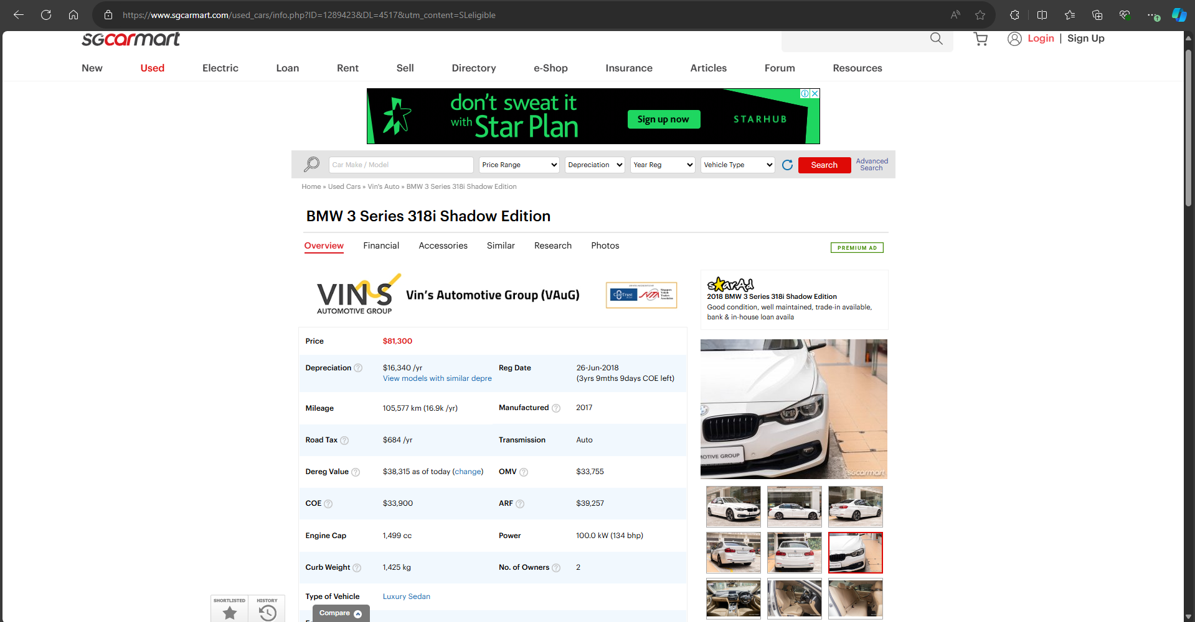
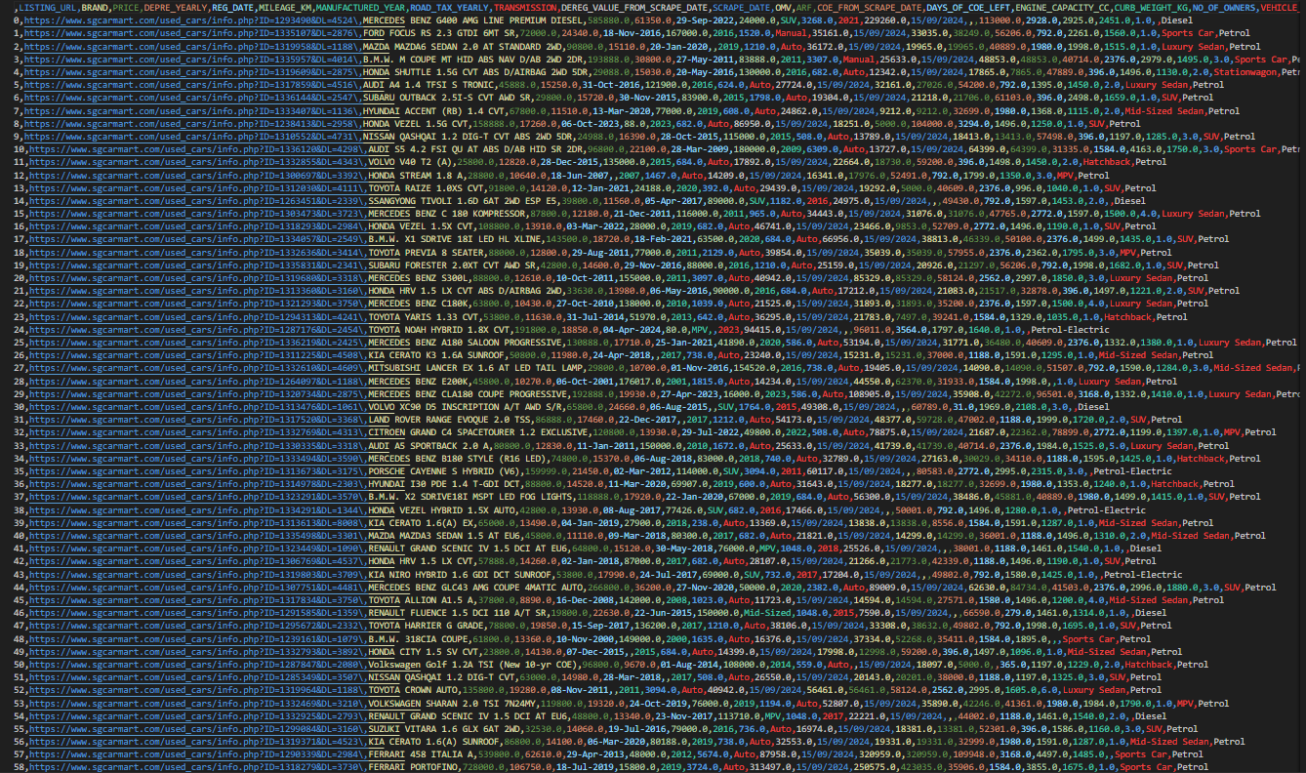
Retrieval specific attributes from a parsed individual car listing URL
Data Extraction
'LISTING_URL', 'BRAND', 'PRICE', 'DEPRE_YEARLY', 'REG_DATE’,
'MILEAGE_KM’, ‘MANUFACTURED_YEAR', 'ROAD_TAX_YEARLY', 'TRANSMISSION', 'DEREG_VALUE_FROM_SCRAPE_DATE’, 'SCRAPE_DATE', 'OMV', 'ARF', 'COE_FROM_SCRAPE_DATE', 'DAYS_OF_COE_LEFT’, 'ENGINE_CAPACITY_CC', 'CURB_WEIGHT_KG', 'NO_OF_OWNERS', 'VEHICLE_TYPE', 'FUEL_TYPE'

Slide 8
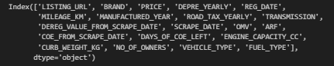
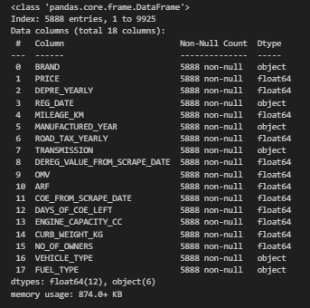
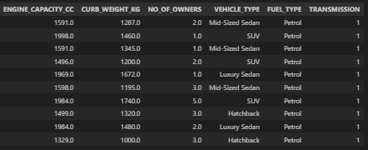
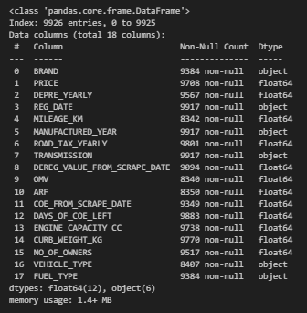
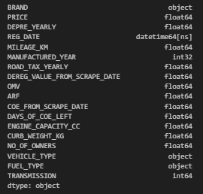
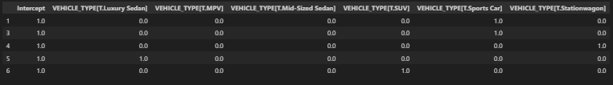
Data Processing/ Optimization
Remove
'LISTING_URL', 'SCRAPE_DATE'
Drop NULL Values
One-hot encoding ‘TRANSMISSION’
Dmatrix to Dummy Variables ‘VEHICLE_TYPE’
Datetime Convert

Slide 9
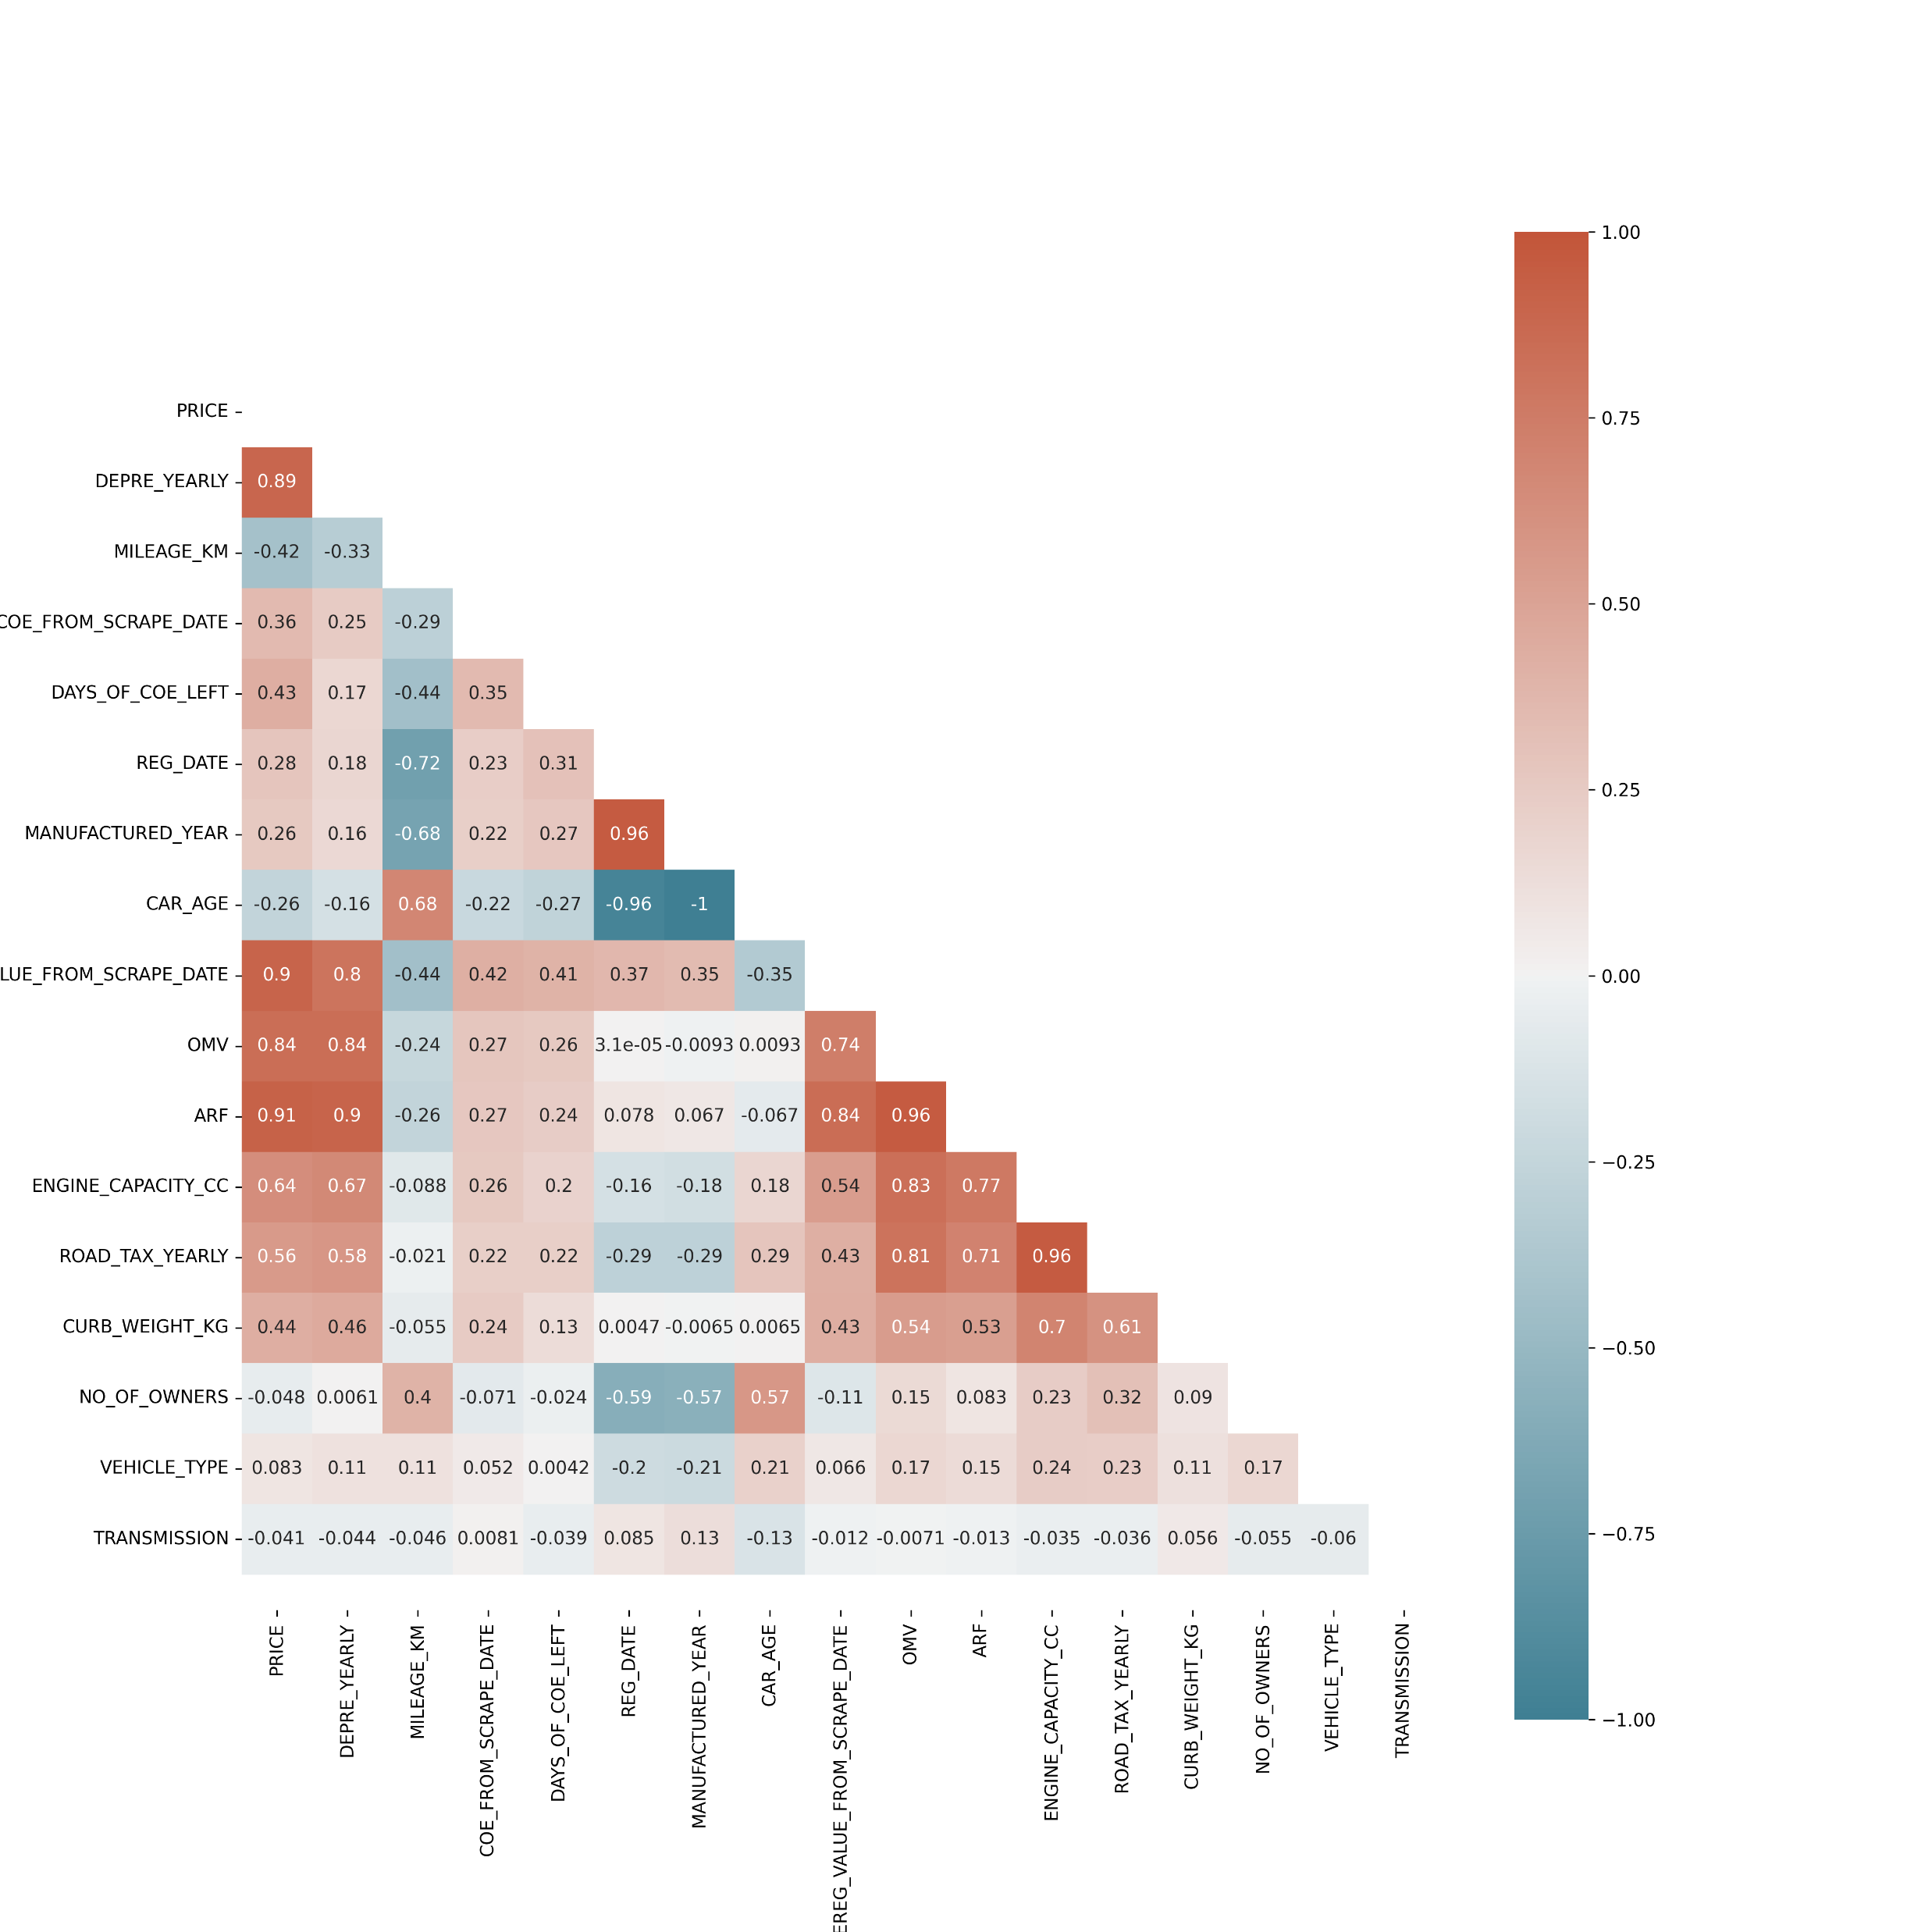
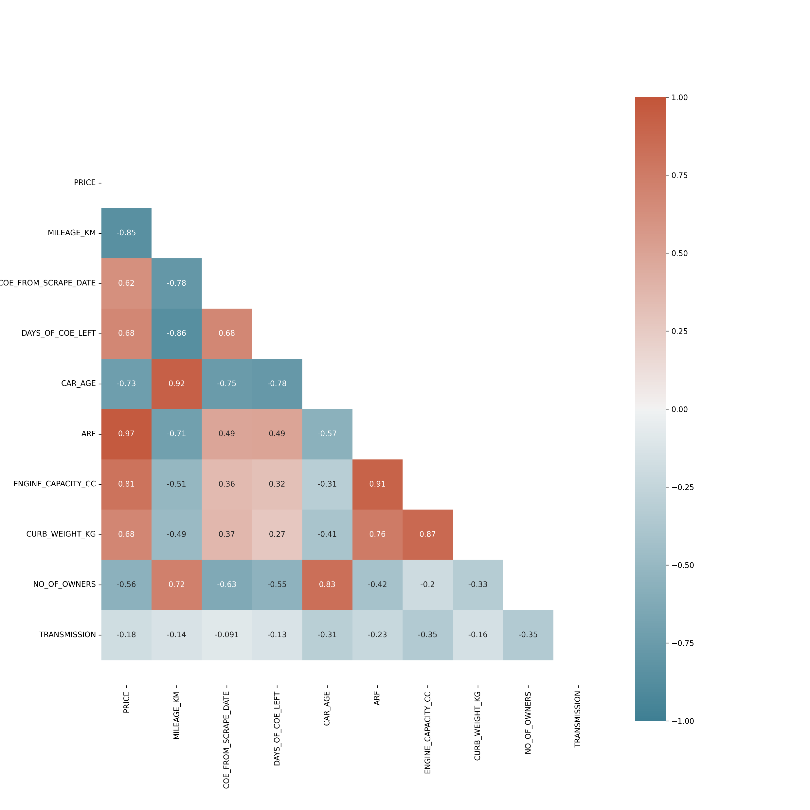
Data Processing/ Optimization
Highly correlated features dropped to avoid multicollinearity:
OMV & ARF correlation of 0.96:
OMV dropped.
Engine CC & Road Tax correlation of 0.96:
Road Tax dropped.
Manufactured Year & Car Age correlation of -1: Manufactured Year dropped.
Deregistration Value & ARF correlation of 0.84: Dereg Value from Scrape Date dropped.
Depreciation & ARF correlation of 0.9:
Depre Yearly dropped.
Registration Date & Car Age correlation -0.96: Reg Date dropped.
Removing these highly correlated features can reduce multicollinearity in the model and improve its performance.

Slide 10
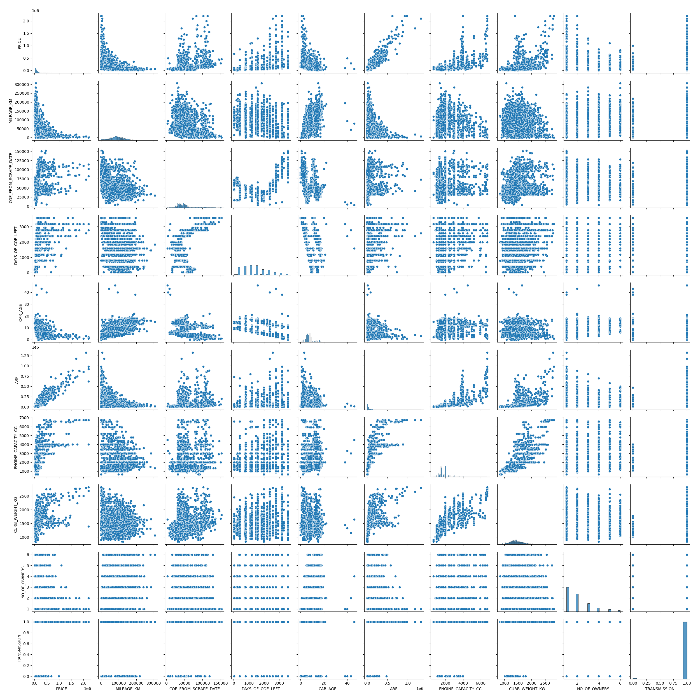
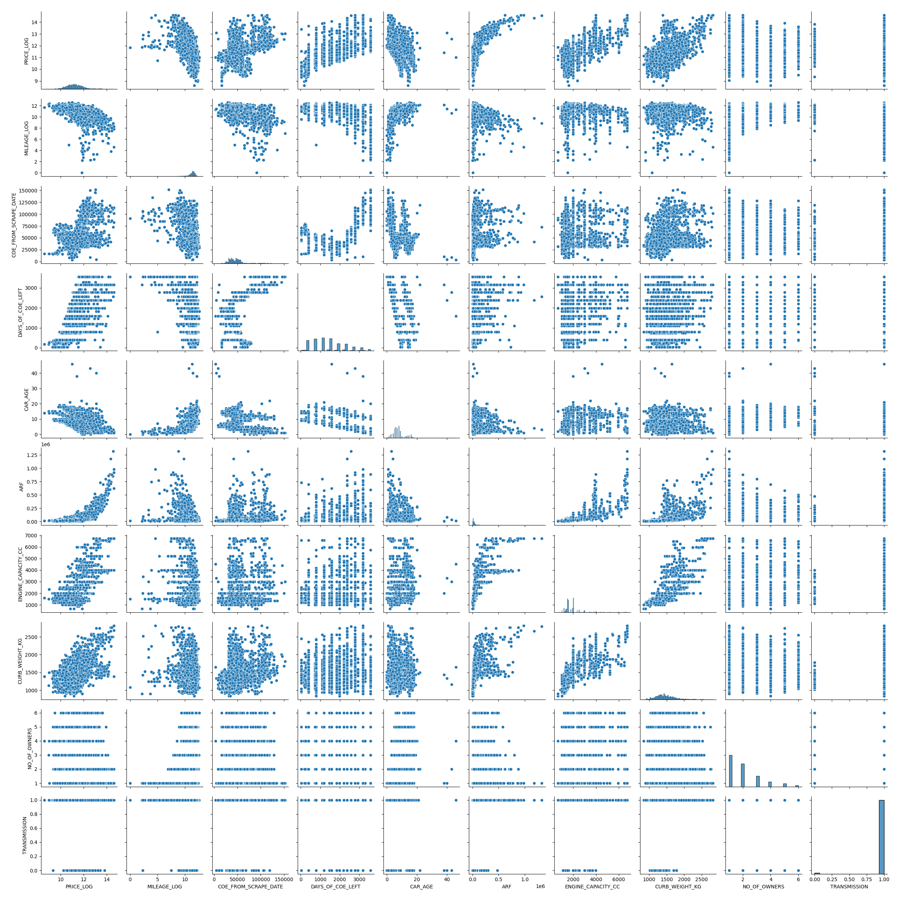
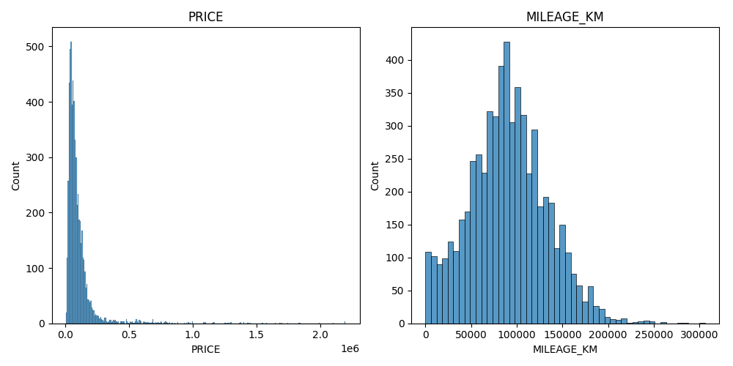
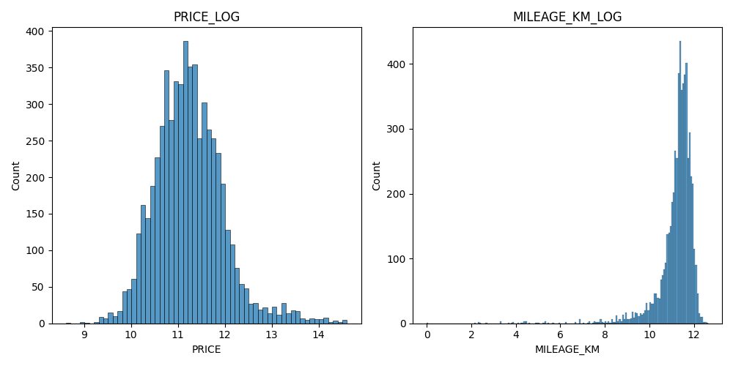
Data Processing/ Optimization

Slide 11
Preliminary Model » Logged Mileage » Logged Mileage and Engine CC² » Logged Price, Logged Mileage and Engine CC² » Logged Price, Logged Mileage and Engine CC(no sq)
Linear VS Random Forest Regression
 | Linear Regression | Random Forest Regression
Preliminary Model | R^2: 0.914 MAE: 20974.92 MSE: 1960061713.28 RMSE: 44272.58 | R^2: 0.917 MAE: 20681.96 MSE: 1899834217.36 RMSE: 43587.09
Logged KM | R^2: 0.9935 MAE: 3917.99 MSE: 148258562.89 RMSE: 12176.15 | R^2: 0.9935 MAE: 3925.59 MSE: 148723770.49 RMSE: 12195.24
Logged KM, Sq Engine CC | R^2: 0.918 MAE: 20481.90 MSE: 1887943343.85 RMSE: 43450.47 | R^2: 0.9935 MAE: 3925.22 MSE: 148690612.67 RMSE: 12193.88
Logged Price, Logged KM, Sq Engine CC | R^2: 0.878 MAE: 0.1793 MSE: 0.0663 RMSE: 0.2575 | R^2: 0.9957 MAE: 0.0315 MSE: 0.0023 RMSE: 0.0483
Logged Price, Logged KM, Engine CC (no sq) | R^2: 0.881 MAE: 0.1806 MSE: 0.0644 RMSE: 0.2538 | R^2: 0.9957 MAE: 0.0315 MSE: 0.0023 RMSE: 0.0483

Slide 12
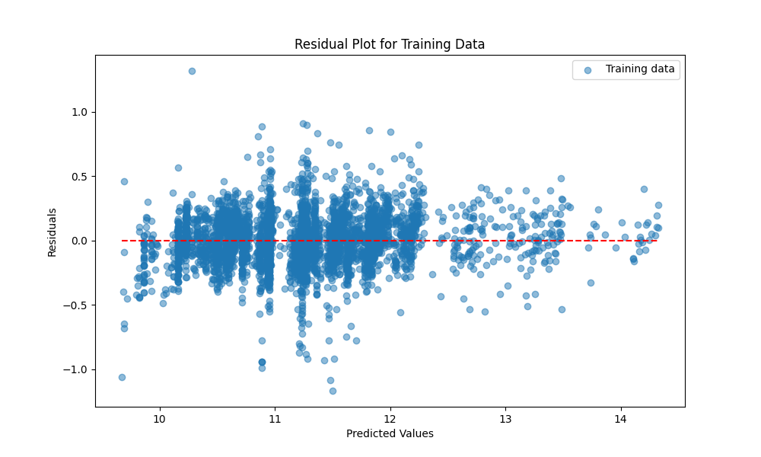
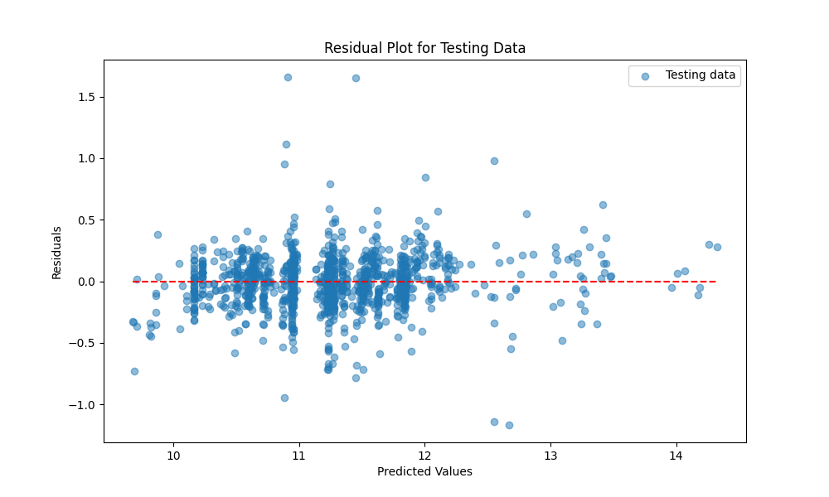
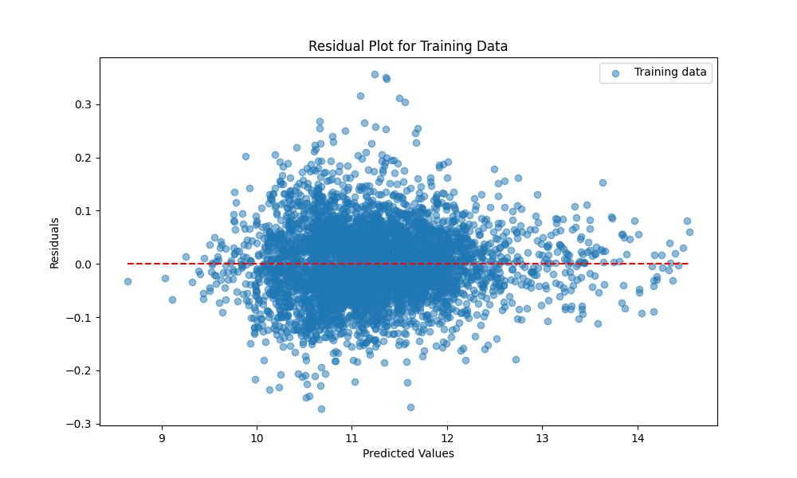
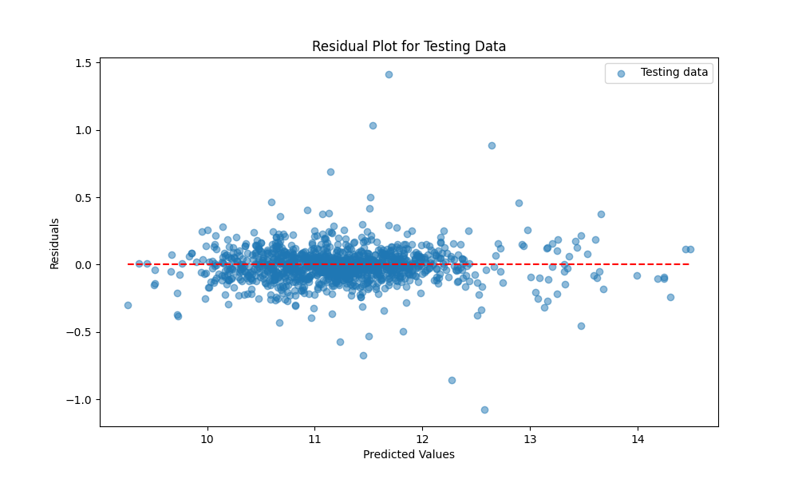
Random Forest vs Gradient Boosting Regression
 | Random Forest Regression | Gradient Boost Regression
Model Testing on Whole Dataset (Training Model at 80%) | R^2: 0.9349787751992766 MAE: 0.1383459211659664 MSE: 0.035115221500906624 RMSE: 0.18739055872937307 | R^2: 0.9914784674106109 MAE: 0.05201313094484405 MSE: 0.0046021203894680476 RMSE: 0.06783892974884
Testing | R^2: 0.9120014085092089 MAE: 0.155792435996898 MSE: 0.04863509717418254 RMSE: 0.22053366449180165 | R^2: 0.965476320646119 MAE: 0.09019939850663643 MSE: 0.01908056108332179 RMSE: 0.13813240417556552

Slide 13
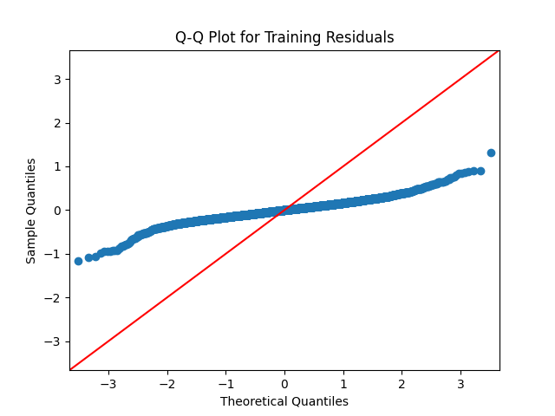
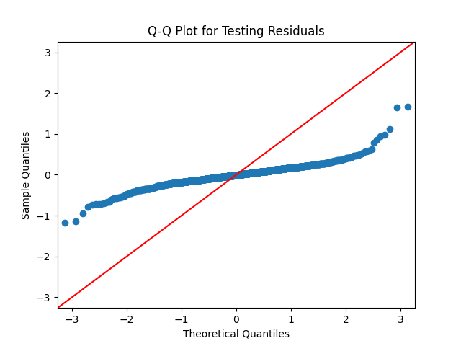
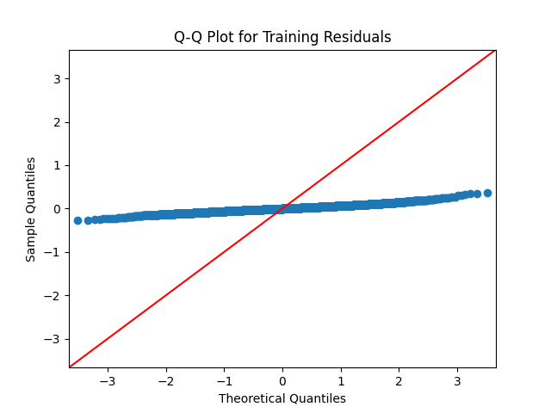
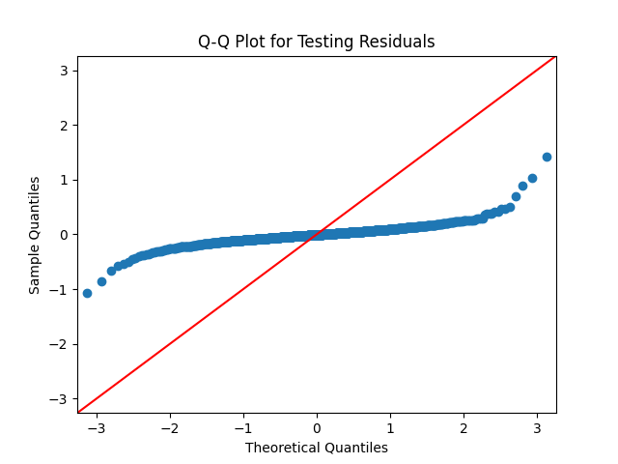
Random Forest vs Gradient Boosting Regression
 | Random Forest Regression | Gradient Boost Regression
Model Testing on Whole Dataset (Training Model at 80%) | R^2: 0.9349787751992766 MAE: 0.1383459211659664 MSE: 0.035115221500906624 RMSE: 0.18739055872937307 | R^2: 0.9914784674106109 MAE: 0.05201313094484405 MSE: 0.0046021203894680476 RMSE: 0.06783892974884
Testing | R^2: 0.9120014085092089 MAE: 0.155792435996898 MSE: 0.04863509717418254 RMSE: 0.22053366449180165 | R^2: 0.965476320646119 MAE: 0.09019939850663643 MSE: 0.01908056108332179 RMSE: 0.13813240417556552

Slide 14
Challenges/ Limitations
Challenges
SgCarMart Website Upgrade
Classification of FUEL_TYPE
Categorization of Vehicle Class
Segregation of Brand Make/ Model
Issues
Upgrade Website Layout: 09/09/2024
Only ‘Petrol’ type after
DropNA
Based on Brands
Variants in same Brand
Make/ Model
Examples

Slide 15
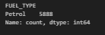
Challenges/ Limitations
Challenges
SgCarMart Website Upgrade
Classification of FUEL_TYPE
Categorization of Vehicle Class
Segregation of Brand Make/ Model
Issues
Upgrade Website Layout: 09/09/2024
Only ‘Petrol’ type after
DropNA
Based on Brands
Variants in same Brand
Make/ Model
Examples

Slide 16
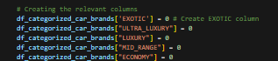
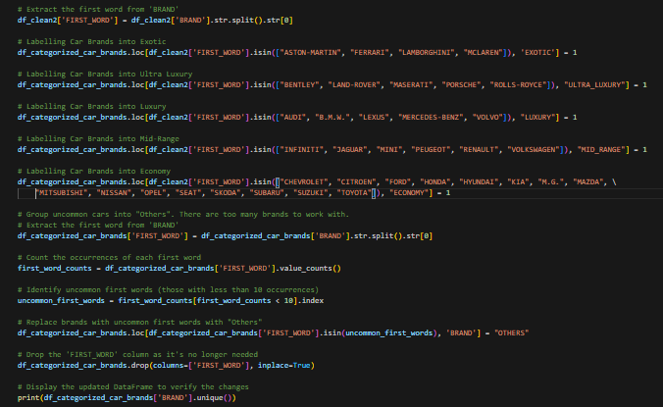
Challenges/ Limitations
Challenges
SgCarMart Website Upgrade
Classification of FUEL_TYPE
Categorization of Vehicle Class
Segregation of Brand Make/ Model
Issues
Upgrade Website Layout: 09/09/2024
Only ‘Petrol’ type after
DropNA
Based on Brands
Variants in same Brand
Make/ Model
Examples

Slide 17
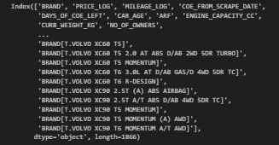
Challenges/ Limitations
Challenges
SgCarMart Website Upgrade
Classification of FUEL_TYPE
Categorization of Vehicle Class
Segregation of Brand Make/ Model
Issues
Upgrade Website Layout: 09/09/2024
Only ‘Petrol’ type after
DropNA
Based on Brands
Variants in same Brand
Make/ Model
Examples

Slide 18
Conclusion: Key Takeaways
Conclusion
Analyzing used car prices from sgcarmart.com using machine learning can be very useful.
The pricing of used cars is complex, but machine learning can handle this.
Predictive models can give accurate estimates, helping buyers and sellers.
Machine learning can identify key price drivers, providing valuable insights.
The website has lots of data, and machine learning can efficiently analyze it.
Machine learning models can adapt as new data becomes available.
Notes:
In today’s data-driven world, organizations are amassing vast quantities of information daily to inform their business strategies and solutions. This surge in data has led to a skyrocketing demand for Data Scientists and Data Analysts. Machine Learning and Artificial Intelligence are at the forefront of this transformation, paving the way for a brighter future. Data has become the “backbone” of the 21st century, with Machine Learning serving as the engine that harnesses its potential.
Machine Learning and AI are now integral to almost every sector. Companies are integrating smart AI solutions to reduce manual interventions. Focusing on cars, we can see how these technologies have revolutionized driving experiences.

